Slide 1
Education Abroad 2018
“Know Before You Go”
Presentation by
Department of Public Safety

Slide 2
Education Abroad 2018
Safety tips while traveling overseas are no different from those given to a local student.
Use the same common sense traveling overseas that you would at home.
Be especially cautious in (or avoid) areas where you may be more easily victimized. These include crowded subways, train stations, elevators, tourist sites, market places, festivals and crime-ridden neighborhoods.

Slide 3
Education Abroad 2018
§ Do not walk alone at night.
Don't use short cuts, narrow alleys or poorly lit streets.
Try not to travel alone at night.
§ Be aware of your surroundings.
§ Keep your wallet or money in your front pocket. Separate your cash from your credit cards.
Ladies, be mindful how you carry your handbag/purses
Only take taxis clearly identified with official markings. Beware of unmarked cabs.

Slide 4
Education Abroad 2018
§ Do not drink alcohol to the point that you are not in control.
Do not leave drinks unattended – drugs may cause sleepiness or amnesia
Avoid public demonstrations and other civil disturbances.
In the confusion, you could be arrested or detained even though you are a bystander
Do not discuss travel plans or other personal matters with strangers.
Financial problems, emotional relationships or other difficulties
May make you a target for exploitation

Slide 5
Education Abroad 2018
Beware of pickpockets. They often have an accomplice who will:
jostle you,
ask you for directions or the time,
point to something spilled on your clothing,
or distract you by creating a disturbance.
Avoid scam artists by being wary of strangers who approach you and offer to be your guide or sell you something at bargain prices.

Slide 6
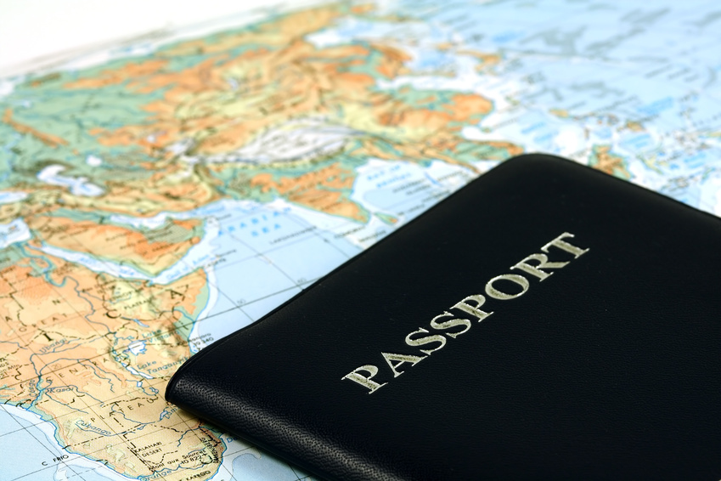
Education Abroad 2018
Protect your passport
Theft of American passports are on the rise (FBI)
If you carry it with you put in a secure place

Slide 7
Education Abroad 2018
Make two (2) photocopies of all your travel documents in case of an emergency.
Leave one copy with a trusted friend or relative at home.
Carry the other copy separately from your documents in case of loss or theft.

Slide 8
Education Abroad 2018
Try to seem purposeful when you move about. Even if you are lost, act as if you know where you are going. Try to ask for directions only from individuals in authority.
Know how to use a pay telephone and have the proper change or token on hand.
Learn a few phrases in the local language.

Slide 9
Education Abroad 2018
Evade criminals and terrorist by being aware of your surroundings
Terrorist acts occur unpredictably, making it impossible to protect yourself absolutely.
Most terrorist attacks are the result of careful planning.

Slide 10
Education Abroad 2018
Make a note of emergency telephone numbers you may need: police, fire, your hotel, and the nearest U.S. embassy or consulate.
If you are confronted, don't fight back -- give up your valuables.
If you are arrested for any reason, ask to notify the nearest U.S. Embassy or Consulate.
A consular officer cannot provide bail or offer free legal aid but they can assist you.
Follow the rules of the Education Abroad program

Slide 11
Education Abroad 2018
Read up on your destination at travel.state.gov.
Learn about visa requirements, local laws, customs and medical care in the country your are visiting.
Check the website of the U.S. embassy or consulate where you will be traveling for the latest security messages.
Prepare to handle money overseas. Before you go, notify your bank and credit card company of your travel, and check exchange rates.

Slide 12
Education Abroad 2018
Know the local equivalent of 911 for your program site.
Contact the CUAbroad 24 hours a day, 7 days a week, call: CUA Public Safety at (001) 202-319-5111
You may also contact CUAbroad during regular office hours at (001) 202-319-6010.

Slide 13
Education Abroad 2018
USE COMMON SENSE
BE SAFE
HAVE A GREAT EXPERIENCE!!

